Slide 1
Diagnostic Numeracy Assessment

Slide 2
Getting Ready:
Create a free Quick Key account at get.quickkeyapp.com
Print the sheet on the next page, or get more blank sheets on your Quick Key dashboard

Slide 3
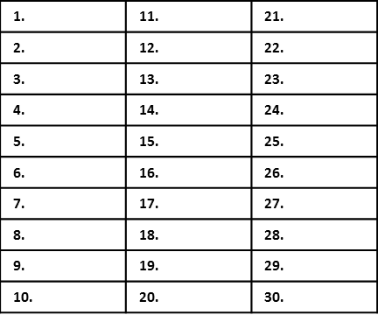
Student ID Number:
Mental Numeracy Strategies Assessment
Timestables Assessment
Key Nodes Assessment
Name:

Slide 4
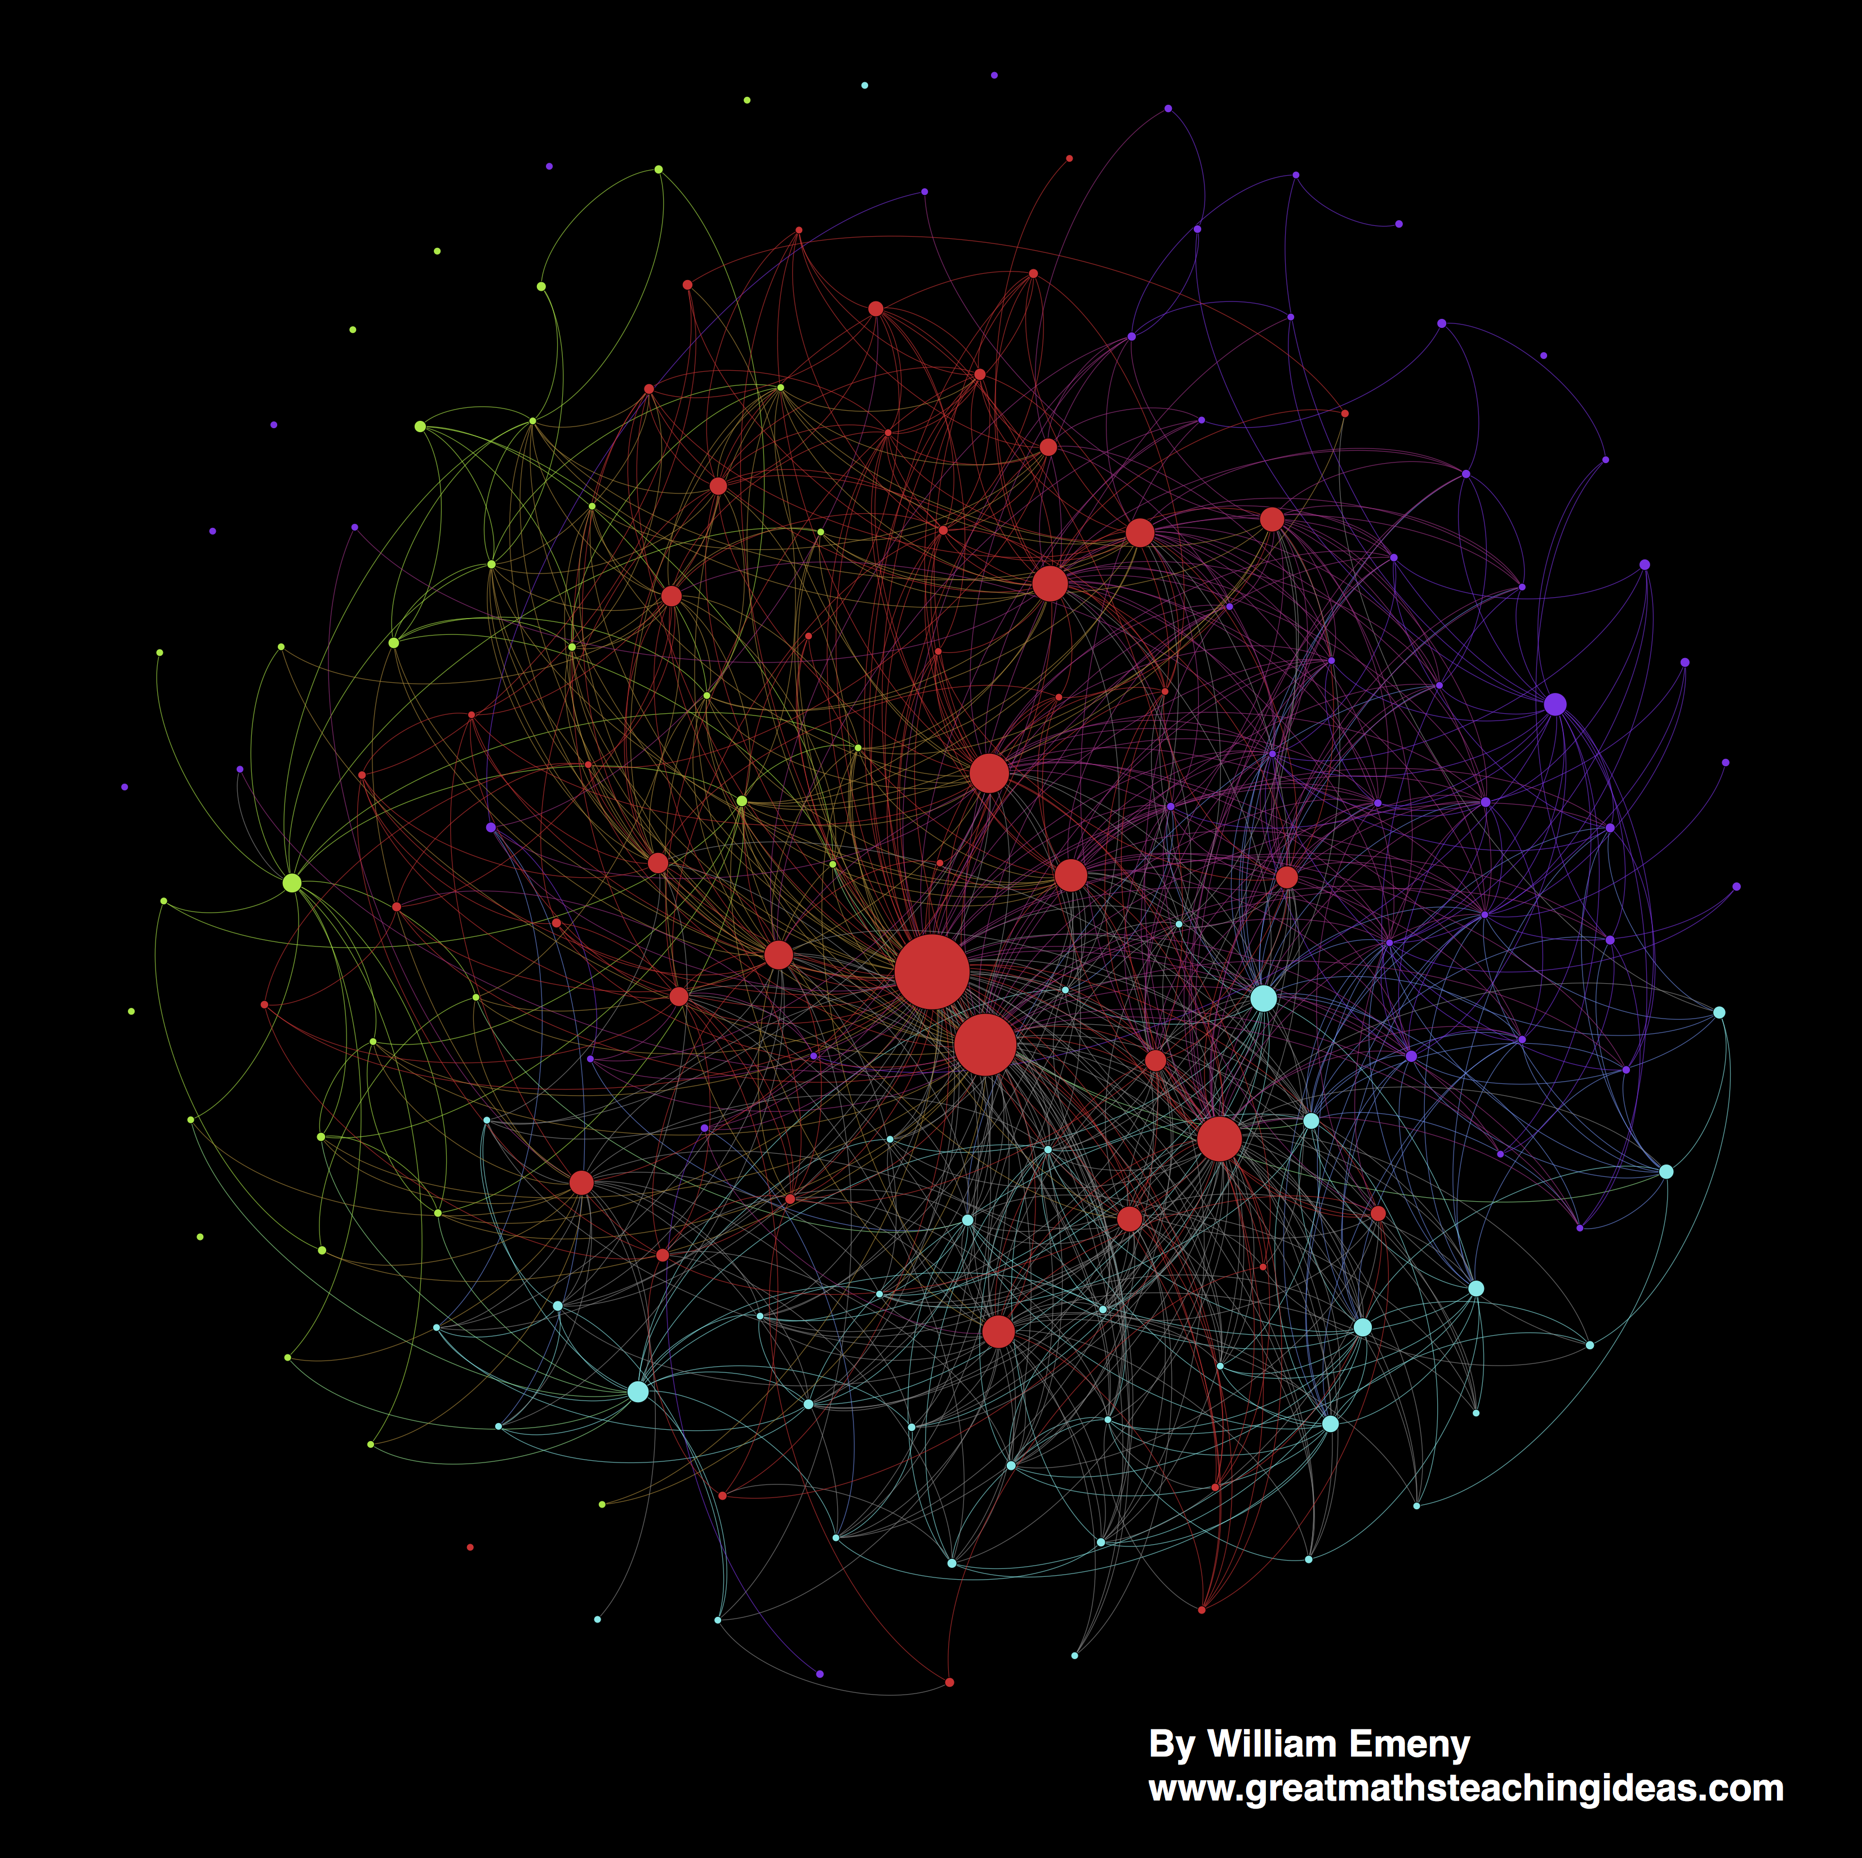
Some things in maths are more important than others
Mr Emeny did an analysis to find out what are the most important topics that you need to master to achieve highly in GCSE maths.
These are…

Slide 5
Some things in maths are more important than others
Timestables
Adding and subtracting
Order of operations
Rounding
Negative numbers
Fractions
and more…

Slide 6
Some things in maths are more important than others
It is important this learning is in your ‘long-term memory’. This means you can answer questions on these topics very quickly ‘without thinking’.
We’re going to do some little assessments so your teacher understands what you can recall quickly from these topics.
The results will be useful for them to plan future lessons to help you improve in your maths.

Slide 7
Make a note of your student ID number

Slide 8
Make a note of your student ID number

Slide 9
Make a note of your student ID number

Slide 10
Make a note of your student ID number

Slide 11
Fill in your name in the ‘student name’ box in each answer sheet
Answer sheet to go in here

Slide 12
Fill in your student ID number in the ‘student #’ box as shown then shade in the numbers in each answer sheet
Answer sheet to go in here

Slide 13
You will see a series of questions and be given a short period of time to answer them. Write the letter of your chosen answer in the answer boxes. If you don’t know an answer leave it blank.
Answer sheet to go in here

Slide 14
Students
We are testing whether you can recall certain maths facts and methods very quickly. We want to understand what you ‘know without having to think’
Don’t worry if you don’t yet know the answers to certain questions within the time limit. This information is going to be used only by your teacher to help them plan their lessons
Keep going, the last question might be the easiest…
You may use a spare piece of paper for doing quick calculations in the first two assessments if you wish
Exam conditions- no communicating with other students

Slide 15
Teachers
Read each question out as well as displaying it on the board
The slides are programmed to change at the correct time intervals
At the end of the assessment:
  Get students to fill in the circles using a pencil. IT MUST BE PERFECT OR THEY WON’T SCAN
  collect in the student papers and pass to Mr Emeny so he can process the results for you

Slide 16
Get Ready!
TIMESTABLES ASSESSMENT
Make sure you fill in the timestables answer box!
Teachers- click once to begin the assessment. The slides will change themselves at the correct intervals.
Please read out each question as it appears

Slide 17

Q1
1 X 5
8 sec
Shade in the correct answer. If you’re unsure leave it blank
A
1
B
0
C
5
D
8
E
-5

Slide 18
Q2
7 X 1
8 sec
Shade in the correct answer. If you’re unsure leave it blank
A
1
B
7
C
0
D
-7
E
3

Slide 19
Q3
1 X 9
8 sec
Shade in the correct answer. If you’re unsure leave it blank
A
9
B
1
C
-9
D
0
E
2

Slide 20
Q4
4 X 2
8 sec
Shade in the correct answer. If you’re unsure leave it blank
A
10
B
2
C
6
D
8
E
4

Slide 21
Q5
2 X 7
8 sec
Shade in the correct answer. If you’re unsure leave it blank
A
16
B
14
C
10
D
18
E
15

Slide 22
Q6
3 X 2
8 sec
Shade in the correct answer. If you’re unsure leave it blank
A
6
B
5
C
8
D
4
E
10

Slide 23
Q7
3 X 4
8 sec
Shade in the correct answer. If you’re unsure leave it blank
A
8
B
12
C
10
D
14
E
15

Slide 24
Q8
9 X 3
8 sec
Shade in the correct answer. If you’re unsure leave it blank
A
36
B
28
C
29
D
30
E
27

Slide 25
Q9
3 X 6
8 sec
Shade in the correct answer. If you’re unsure leave it blank
A
15
B
17
C
16
D
21
E
18

Slide 26
Q10
4 X 5
8 sec
Shade in the correct answer. If you’re unsure leave it blank
A
25
B
18
C
20
D
24
E
16

Slide 27
Q11
8 X 4
8 sec
Shade in the correct answer. If you’re unsure leave it blank
A
28
B
32
C
36
D
30
E
34

Slide 28
Q12
4 X 6
8 sec
Shade in the correct answer. If you’re unsure leave it blank
A
20
B
24
C
22
D
18
E
26

Slide 29
Q13
5 X 7
8 sec
Shade in the correct answer. If you’re unsure leave it blank
A
35
B
30
C
45
D
40
E
25

Slide 30
Q14
3 X 5
8 sec
Shade in the correct answer. If you’re unsure leave it blank
A
10
B
20
C
5
D
15
E
25

Slide 31
Q15
5 X 9
8 sec
Shade in the correct answer. If you’re unsure leave it blank
A
50
B
40
C
45
D
35
E
55

Slide 32
Q16
6 X 8
8 sec
Shade in the correct answer. If you’re unsure leave it blank
A
30
B
54
C
46
D
58
E
48

Slide 33
Q17
10 X 6
8 sec
Shade in the correct answer. If you’re unsure leave it blank
A
60
B
50
C
70
D
66
E
52

Slide 34
Q18
6 X 9
8 sec
Shade in the correct answer. If you’re unsure leave it blank
A
52
B
56
C
60
D
58
E
54

Slide 35
Q19
3 X 7
8 sec
Shade in the correct answer. If you’re unsure leave it blank
A
18
B
21
C
24
D
22
E
14

Slide 36
Q20
7 X 6
8 sec
Shade in the correct answer. If you’re unsure leave it blank
A
38
B
42
C
40
D
43
E
37

Slide 37
Q21
7 X 8
8 sec
Shade in the correct answer. If you’re unsure leave it blank
A
54
B
58
C
52
D
56
E
62

Slide 38
Q22
2 X 8
8 sec
Shade in the correct answer. If you’re unsure leave it blank
A
16
B
14
C
18
D
15
E
19

Slide 39
Q23
8 X 9
8 sec
Shade in the correct answer. If you’re unsure leave it blank
A
80
B
74
C
76
D
72
E
68

Slide 40
Q24
3 X 8
8 sec
Shade in the correct answer. If you’re unsure leave it blank
A
16
B
24
C
28
D
22
E
26

Slide 41
Q25
2 X 9
8 sec
Shade in the correct answer. If you’re unsure leave it blank
A
18
B
17
C
16
D
21
E
19

Slide 42
Q26
9 X 4
8 sec
Shade in the correct answer. If you’re unsure leave it blank
A
34
B
42
C
35
D
38
E
36

Slide 43
Q27
7 X 9
8 sec
Shade in the correct answer. If you’re unsure leave it blank
A
62
B
64
C
63
D
72
E
54

Slide 44
Q28
2 X 10
8 sec
Shade in the correct answer. If you’re unsure leave it blank
A
20
B
10
C
30
D
50
E
2

Slide 45
Q29
10 X 4
8 sec
Shade in the correct answer. If you’re unsure leave it blank
A
4
B
20
C
30
D
40
E
10

Slide 46
Q30
10 X 10
8 sec
Shade in the correct answer. If you’re unsure leave it blank
A
110
B
90
C
10
D
100
E
1000

Slide 47
Take a 2 min break before the next assessment
Discuss with the person next to you:
what topics in maths rely on you knowing your timestables?
if you don’t know them all yet, what actions will you take to learn them?

Slide 48
Get Ready!
KEY NODES ASSESSMENT
Make sure you fill in the KEY NODES box!
Teachers- click once to begin the assessment. The slides will change themselves at the correct intervals.
Please read out each question as it appears
YOU WILL NEED A SPARE PIECE OF PAPER TO DO SOME QUICK CALCULATIONS IN THIS ASSESSMENT

Slide 49
Q1
30 ÷ 5
8 sec
Shade in the correct answer. If you’re unsure leave it blank
A
5
B
6
C
10
D
7
E
8

Slide 50
Q2
378 + 59
Hint- use a quick written method
25 sec
Shade in the correct answer. If you’re unsure leave it blank
A
448
B
447
C
442
D
427
E
437

Slide 51
Q3
208 - 156
Hint- use a quick written method
25 sec
Shade in the correct answer. If you’re unsure leave it blank
A
52
B
54
C
62
D
61
E
42

Slide 52
Q4
3 + 2 X 5
15 sec
Shade in the correct answer. If you’re unsure leave it blank
A
20
B
25
C
13
D
7
E
30

Slide 53
Q5
4²-(2+1)²
25 sec
Shade in the correct answer. If you’re unsure leave it blank
A
6
B
-1
C
7
D
2
E
25

Slide 54
Q6
3 X 0.8
15 sec
Shade in the correct answer. If you’re unsure leave it blank
A
0.24
B
0.024
C
24
D
2.4
E
240

Slide 55
Q7
3.6 ÷ 4
15 sec
Shade in the correct answer. If you’re unsure leave it blank
A
0.9
B
9
C
0.09
D
90
E
1.8

Slide 56
Q8
What is the value of the 3 digit in the number 230 000
15 sec
Shade in the correct answer. If you’re unsure leave it blank
A
3 units
B
3 thousands
C
3 millions
D
3 tens of thousands
E
3 hundreds

Slide 57
Q9
What is the value of the 4 digit in the number 3.074
15 sec
Shade in the correct answer. If you’re unsure leave it blank
A
4 hundredths
B
4 thousandths
C
4 millionths
D
4 tenths
E
4 units

Slide 58
Q10
3.756 X 100
15 sec
Shade in the correct answer. If you’re unsure leave it blank
A
37.56
B
3.75600
C
3756
D
3700
E
375.6

Slide 59
Q11
27 ÷ 1000
15 sec
Shade in the correct answer. If you’re unsure leave it blank
A
0.027
B
27000
C
2.7
D
0.27
E
27.00

Slide 60
Q12
3.5 + 12.45
Hint- use a quick written method
25 sec
Shade in the correct answer. If you’re unsure leave it blank
A
47.45
B
15.5
C
15.95
D
12.8
E
8.95

Slide 61
Q13
7.3 – 3.46
Hint- use a quick written method
25 sec
Shade in the correct answer. If you’re unsure leave it blank
A
3.94
B
3.8
C
3.16
D
3.57
E
3.84

Slide 62
Q14
-3 X 5
10 sec
Shade in the correct answer. If you’re unsure leave it blank
A
15
B
-15
C
-5
D
3
E
-3

Slide 63
Q15
-12 ÷ -4
10 sec
Shade in the correct answer. If you’re unsure leave it blank
A
3
B
-4
C
-3
D
6
E
4

Slide 64
Q16
Write this fraction in its lowest terms
3
12
15 sec
Shade in the correct answer. If you’re unsure leave it blank
A
1.5
6
B
6
24
C
3
4
D
1
4
E
1
3

Slide 65
Q17
Round 12.374 to 1 d.p.
15 sec
Shade in the correct answer. If you’re unsure leave it blank
A
12.0
B
12.3
C
12
D
12.3
E
12.4

Slide 66
Q18
If x = 3, what is the value of 3x² ?
20 sec
Shade in the correct answer. If you’re unsure leave it blank
A
81
B
18
C
27
D
36
E
9

Slide 67
Q19
-3 - 5
15 sec
Shade in the correct answer. If you’re unsure leave it blank
A
8
B
2
C
-2
D
-8
E
-15

Slide 68
Q20
5 + -2
15 sec
Shade in the correct answer. If you’re unsure leave it blank
A
7
B
3
C
-3
D
-7
E
-10

Slide 69
Q21
-6 - -4
15 sec
Shade in the correct answer. If you’re unsure leave it blank
A
-2
B
10
C
2
D
24
E
-10

Slide 70

Q22
What number is shown by the arrow?
100
120
140
160
20 sec
Shade in the correct answer. If you’re unsure leave it blank
A
124
B
135
C
120.3
D
126
E
132

Slide 71
Q23
Round 0.20546 to 2 significant figures
15 sec
Shade in the correct answer. If you’re unsure leave it blank
A
0.3
B
0.20
C
0.2
D
0.21
E
0.205

Slide 72
Q24
Which is the longest side in this triangle?
A
10 sec
B
C
Shade in the correct answer. If you’re unsure leave it blank
A
AC
B
AB
C
A
D
BC
E
ABC

Slide 73
Q25
What is the three-letter angle notation for angle x?
A
x
15 sec
B
C
Shade in the correct answer. If you’re unsure leave it blank
A
∠ABC
B
∠BAC
C
∠AAA
D
∠CBA
E
∠BxC

Slide 74
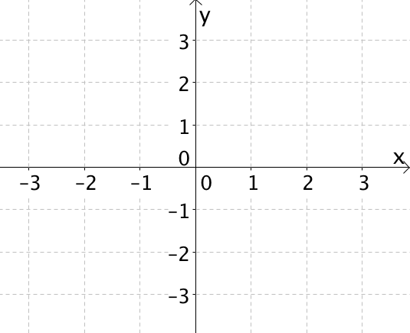
Q26
Which letter
is at coordinate
(-2, 3)?
A
D
E
15 sec
C
B
Shade in the correct answer. If you’re unsure leave it blank
A
A
B
B
C
C
D
D
E
E

Slide 75
Q27
What is the value of 3²?
10 sec
Shade in the correct answer. If you’re unsure leave it blank
A
9
B
27
C
3
D
6
E
32

Slide 76
Q28
What is the value of 2³?
15 sec
Shade in the correct answer. If you’re unsure leave it blank
A
23
B
9
C
12
D
6
E
8

Slide 77
Q29
Which fraction is equivalent to
3
5
?
20 sec
Shade in the correct answer. If you’re unsure leave it blank
A
3
10
B
6
15
C
9
12
D
12
20
E
30
40

Slide 78
Q30
Tom gets £12 pocket money. He spends £5 of it. What fraction of his pocket money did he spend?
20 sec
Shade in the correct answer. If you’re unsure leave it blank
A
17
5
B
12
5
C
5
17
D
5
12
E
12
17

Slide 79
Take a 2 min break before the final assessment
Discuss with the person next to you:
why do you think the questions you’ve just seen are the most important topics to master before you study GCSE maths?
name 5 different things you could do to teach yourself these topics

Slide 80
Get Ready!
MENTAL NUMERACY STRATEGIES ASSESSMENT
Make sure you fill in the MENTAL NUMERACY STRATEGIES box!
Teachers- click once to begin the assessment. The slides will change themselves at the correct intervals.
Please read out each question as it appears
PLEASE DO NOT WRITE DOWN ANY CALCULATIONS. DO THESE QUESTION IN YOUR HEAD

Slide 81
Q1
3 + ? = 5
8 sec
Shade in the correct answer. If you’re unsure leave it blank
A
4
B
2
C
1
D
3
E
5

Slide 82
Q2
1 + ? = 5
8 sec
Shade in the correct answer. If you’re unsure leave it blank
A
1
B
3
C
2
D
4
E
5

Slide 83
Q3
6 + ? = 10
8 sec
Shade in the correct answer. If you’re unsure leave it blank
A
4
B
9
C
1
D
7
E
3

Slide 84
Q4
? + 2 = 10
8 sec
Shade in the correct answer. If you’re unsure leave it blank
A
9
B
7
C
4
D
6
E
8

Slide 85
Q5
? + 14 = 20
8 sec
Shade in the correct answer. If you’re unsure leave it blank
A
7
B
4
C
6
D
5
E
11

Slide 86
Q6
? + 2 = 20
8 sec
Shade in the correct answer. If you’re unsure leave it blank
A
14
B
18
C
19
D
16
E
7

Slide 87
Q7
? + 32 = 100
8 sec
Shade in the correct answer. If you’re unsure leave it blank
A
78
B
58
C
52
D
68
E
72

Slide 88
Q8
83 + ? = 100
8 sec
Shade in the correct answer. If you’re unsure leave it blank
A
27
B
7
C
37
D
23
E
17

Slide 89
Q9
Double 8
8 sec
Shade in the correct answer. If you’re unsure leave it blank
A
15
B
16
C
12
D
18
E
14

Slide 90
Q10
Double 46
15 sec
Shade in the correct answer. If you’re unsure leave it blank
A
80
B
92
C
90
D
82
E
72

Slide 91
Q11
Half of 7
10 sec
Shade in the correct answer. If you’re unsure leave it blank
A
3.5
B
3.25
C
4
D
4.5
E
3

Slide 92
Q12
Half of 27
15 sec
Shade in the correct answer. If you’re unsure leave it blank
A
14.5
B
14
C
14.25
D
13.5
E
13

Slide 93
Q13
57 + 10
8 sec
Shade in the correct answer. If you’re unsure leave it blank
A
75
B
65
C
57
D
77
E
67

Slide 94
Q14
147 - 10
8 sec
Shade in the correct answer. If you’re unsure leave it blank
A
137
B
130
C
147
D
157
E
127

Slide 95
Q15
77 + 50
15 sec
Shade in the correct answer. If you’re unsure leave it blank
A
137
B
130
C
147
D
157
E
127

Slide 96
Q16
325 - 40
15 sec
Shade in the correct answer. If you’re unsure leave it blank
A
365
B
275
C
300
D
285
E
295

Slide 97
Q17
143 + ? = 150
10 sec
Shade in the correct answer. If you’re unsure leave it blank
A
6
B
16
C
9
D
7
E
2

Slide 98
Q18
7 + 8
10 sec
Shade in the correct answer. If you’re unsure leave it blank
A
18
B
14
C
16
D
13
E
15

Slide 99
Q19
Two numbers that add up to 8
12 sec
Shade in the correct answer. If you’re unsure leave it blank
A
4
and
3
B
6
and
3
C
1
and
6
D
7
and
2
E
3
and
5

Slide 100
Q20
Two numbers that add up to 73
15 sec
Shade in the correct answer. If you’re unsure leave it blank
A
25
and
50
B
40
and
33
C
4
and
70
D
3
and
60
E
50
and
33

Slide 101
Q21
18 + 7 = 18 + 2 + ?
12 sec
Shade in the correct answer. If you’re unsure leave it blank
A
8
B
6
C
5
D
4
E
7

Slide 102
Q22
35 – 9 = 35 – 5 – ?
12 sec
Shade in the correct answer. If you’re unsure leave it blank
A
4
B
6
C
2
D
5
E
3

Slide 103
Q23
236 - 231
10 sec
Shade in the correct answer. If you’re unsure leave it blank
A
5
B
2
C
3
D
9
E
4

Slide 104
Q24
2 + 359
10 sec
Shade in the correct answer. If you’re unsure leave it blank
A
359
B
361
C
360
D
363
E
362

Slide 105
Q25
3 + 3 + 3 + 3 + 3
is the same as
15 sec
Shade in the correct answer. If you’re unsure leave it blank
A
5³
B
5 + 3
C
3 X 3
D
3⁵
E
5 X 3

Slide 106
Q26
3 X 8 = 24
can help me work out the answer to…
15 sec
Shade in the correct answer. If you’re unsure leave it blank
A
24 X 8
B
8 ÷ 24
C
3 X 24
D
24 ÷ 3
E
3 ÷ 24

Slide 107
Q27
To make working out
32 + 19 easier, I could do the following calculation instead…
20 sec
Shade in the correct answer. If you’re unsure leave it blank
A
30 + 20 - 2
B
30 + 2 + 20
C
32 + 20 - 1
D
32 + 20 + 1
E
19 + 30

Slide 108
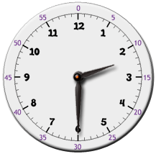
Q28
What is the time on this clock?
15 sec
Shade in the correct answer. If you’re unsure leave it blank
A
Half past 3
B
6:12
C
2:06
D
Half past 2
E
Quarter past 2

Slide 109

Q29
What is the time on this clock?
15 sec
Shade in the correct answer. If you’re unsure leave it blank
A
5 minutes to 2
B
1:11
C
10 minutes to 2
D
2:11
E
1 minute to 2

Slide 110
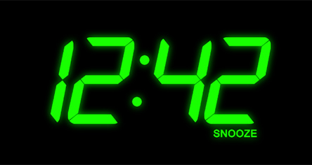
Q30
How many minutes until 1 o’clock?
20 sec
Shade in the correct answer. If you’re unsure leave it blank
A
58
B
8
C
18
D
28
E
48

Slide 111
The assessment in now over. Well done for your persistence!
NOW FILL IN THE CIRCLES ON THE ANSWER SHEET TO MATCH YOUR ANSWERS. USE A PENCIL.
IF YOU MAKE A MISTAKE TELL YOUR TEACHER…

